Slide 1
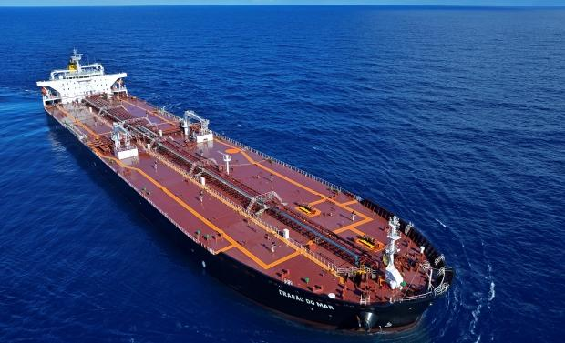




Poli
marine
SHIP DESIGN
OIL TANKER
São Paulo, 20th of October of 2023
GROUP 3
ENGINEERS
Breno Guedes Gallo
Marcos Vicente Soares Pifano
Thiago Aguiar Lima

Slide 2
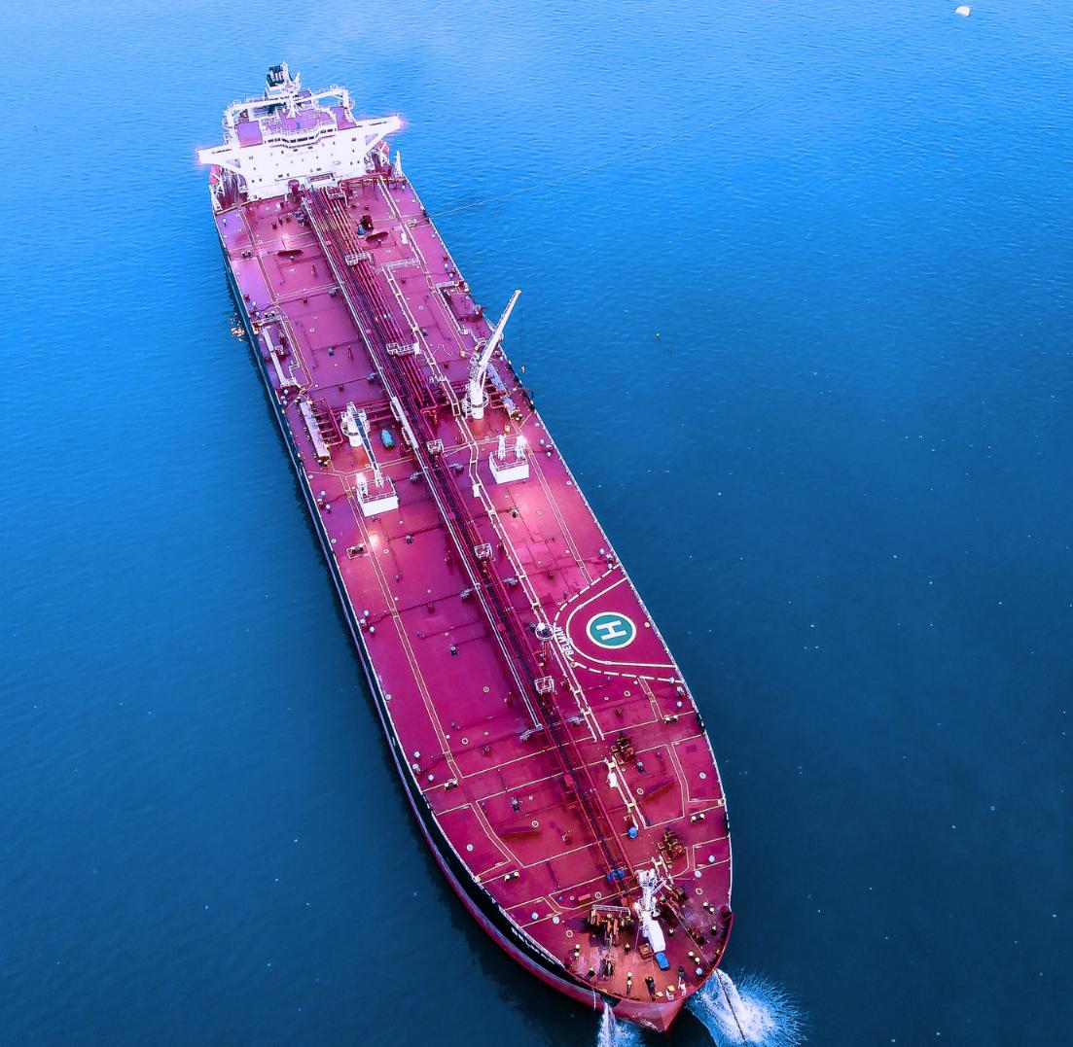


AGENDA
1. SHIPOWNER REQUIREMENTS
2. FIRST ESTIMATES
3. WEIGHTS AND CENTERS
4. SPACE AND ARRANGEMENT
5. STABILITY
Poli
marine
PNV3415 – Project of Ships

Slide 3





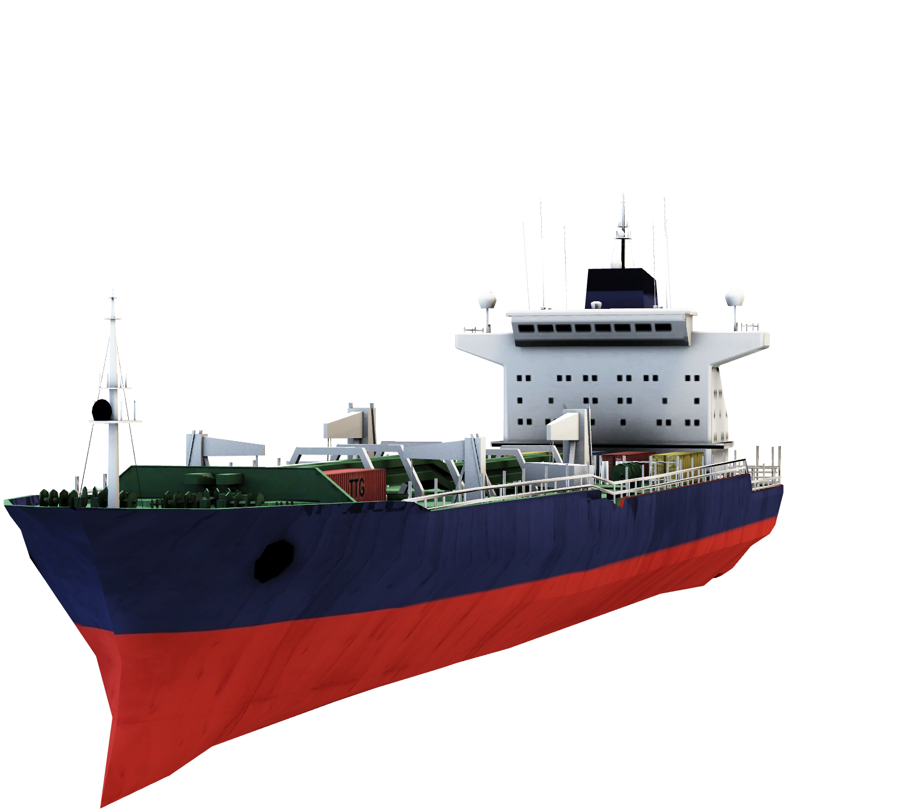
Poly
marine
REQUIREMENTS
SHIP OWNER
ROUTE
ALGERIA - USA/HOLLAND/UK
AUTONOMY
6,000 NAUTICAL MILES
PRODUCT
CRUDE OIL
SPEED
15.7 KNOTS
DEADWEIGHT CARGO
115,500 TONS
DRAFT 11
4

Slide 4
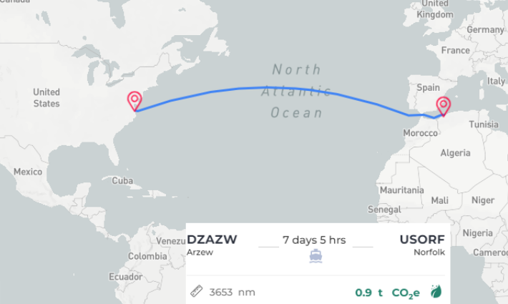


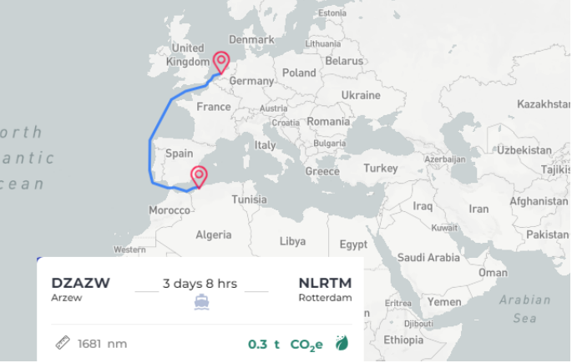
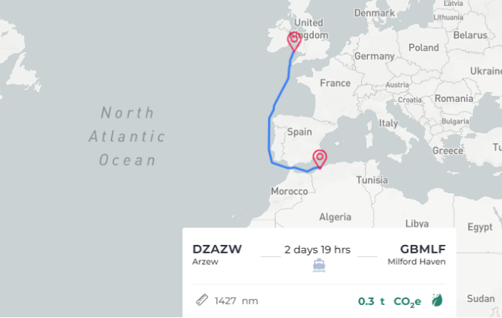


ARZEW PORT
Algeria is the largest producer of crude oil in the African continent, and a member of OPEC since 1961.Arzew is a medium-sized port with the following restrictions:
PORT OF VIRGINIA
Maximum draft of 14.5 m
Maximum LOA of 300 m
Maximum DWT of 181,433 tons
It has the Norfolk Naval base. The largest ship that ever docked in the port was 396m long.The draft maximum is 15.24m.
PORT OF ROTTERDAM
PORT OF MILFORD HAVEN
The port has the capacity to accommodate ULCC type oil tankers, supporting adraft of up to 22.55m.
Located in Wales, the channel exceeds 17m in all tidal states.The maximum draft is 16.1m to dock.
5

Slide 5


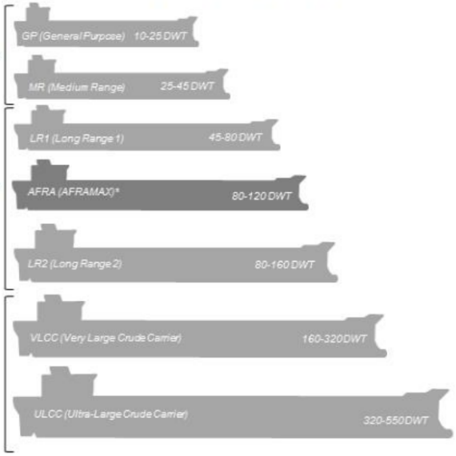



SHIP CHARACTERISTICS
AFRAMAX CLASS
CARGO CHARACTERISTICS
ALGERIAN CRUDE OIL
Products
refined
The density of oils is measured by its API gravity, which is classified as follows:
• Light: Less than 870 kg/m³ (more than 31.1° API) Mediterranean
• Medium: 870 to 920 kg/m³ (31.1° API to 22.3° API)
• Heavy: 920 to 1000 kg/m³ (22.3° API to 10° API) Venezuela
• Extra Heavy: More than 1000 kg/m³ (less than 10° API)
Source:
Products
Refined
Or oil
crude
Oil field of Hassi Berkine
Oil
crude
820 kg/m³ (42°API)
MAIN SYSTEMS OF AN OIL TANKER:
MAIN CARGO CONCERNS:
Cargo pumping systems;
Tank cleaning systems;
Tank ventilation and inert gas systems;
Ballast system.
Risk of explosion;
Risk of spillage.
6

Slide 6
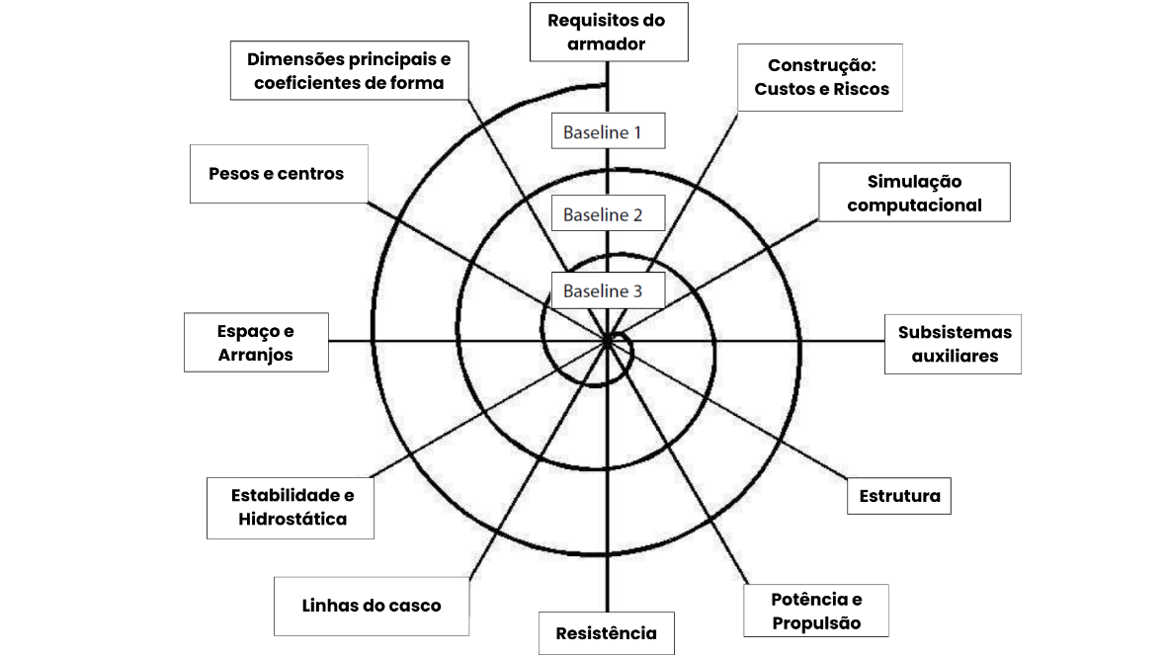
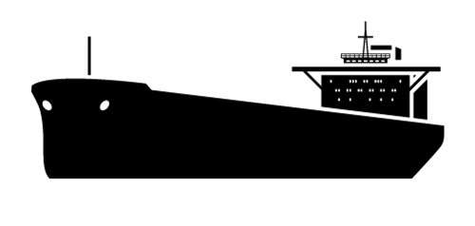
SPIRAL OF
PROJECT
Poly
marine
7

Slide 7
AGENDA
1. SHIPOWNER REQUIREMENTS
2. FIRST ESTIMATES
3. WEIGHTS AND CENTERS
4. SPACE AND ARRANGEMENT
5. STABILITY
Poli
marine
PNV3415 – Project of Ships

Slide 8
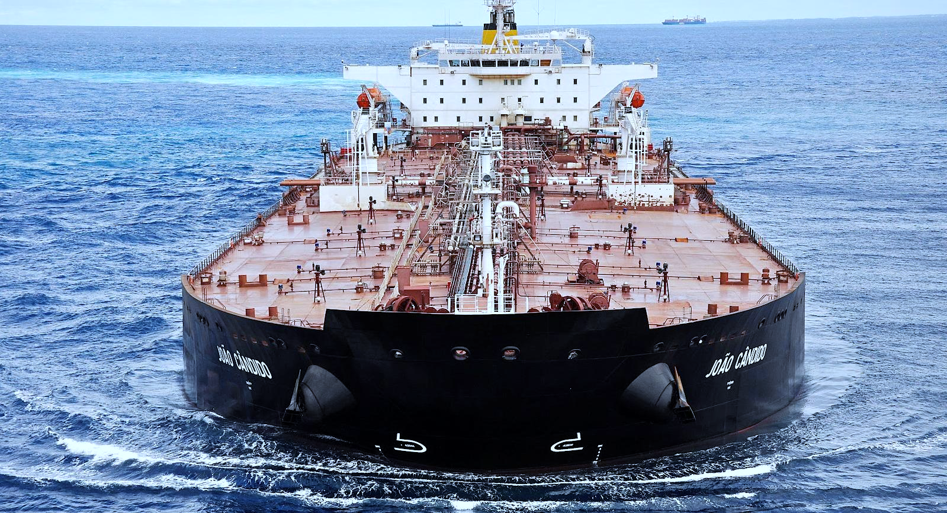


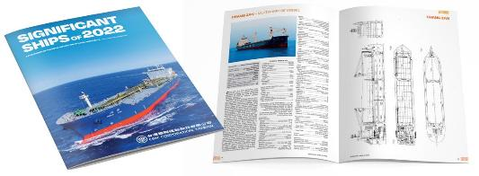


REFERENCES
OF SHIPS
SIMILAR SHIPS
DATABASE
9

Slide 9
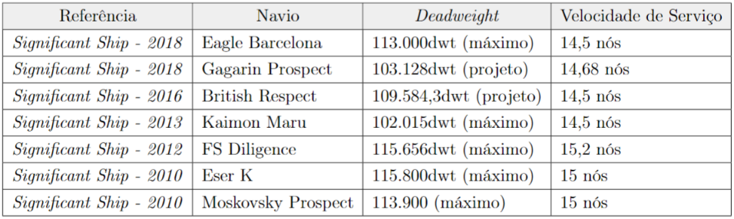
REFERENCES
OF SHIPS
SIMILAR SHIPS
390 SHIPS
1537 SHIPS
10

Slide 10
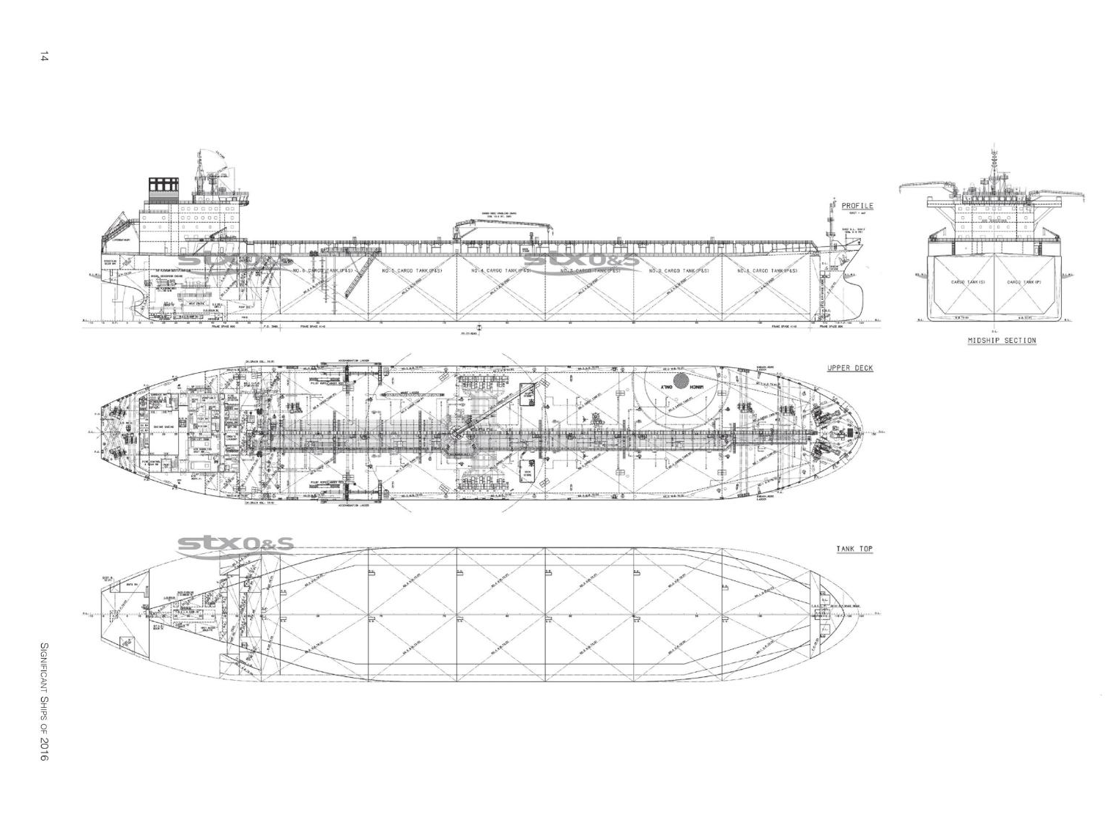



SHIP
SIMILAR
BUILT IN
SOUTH KOREA
• LOA: 249.85 m
• LBP: 239 m
• Breadth: 44 m
• Depth: 21.3 m
• Draft: 15 m
• Speed (75% MCR): 14.5 knots
• Cargo capacity: 124.9 k m³
• DWT (design): 109.5 k tons
11

Slide 11
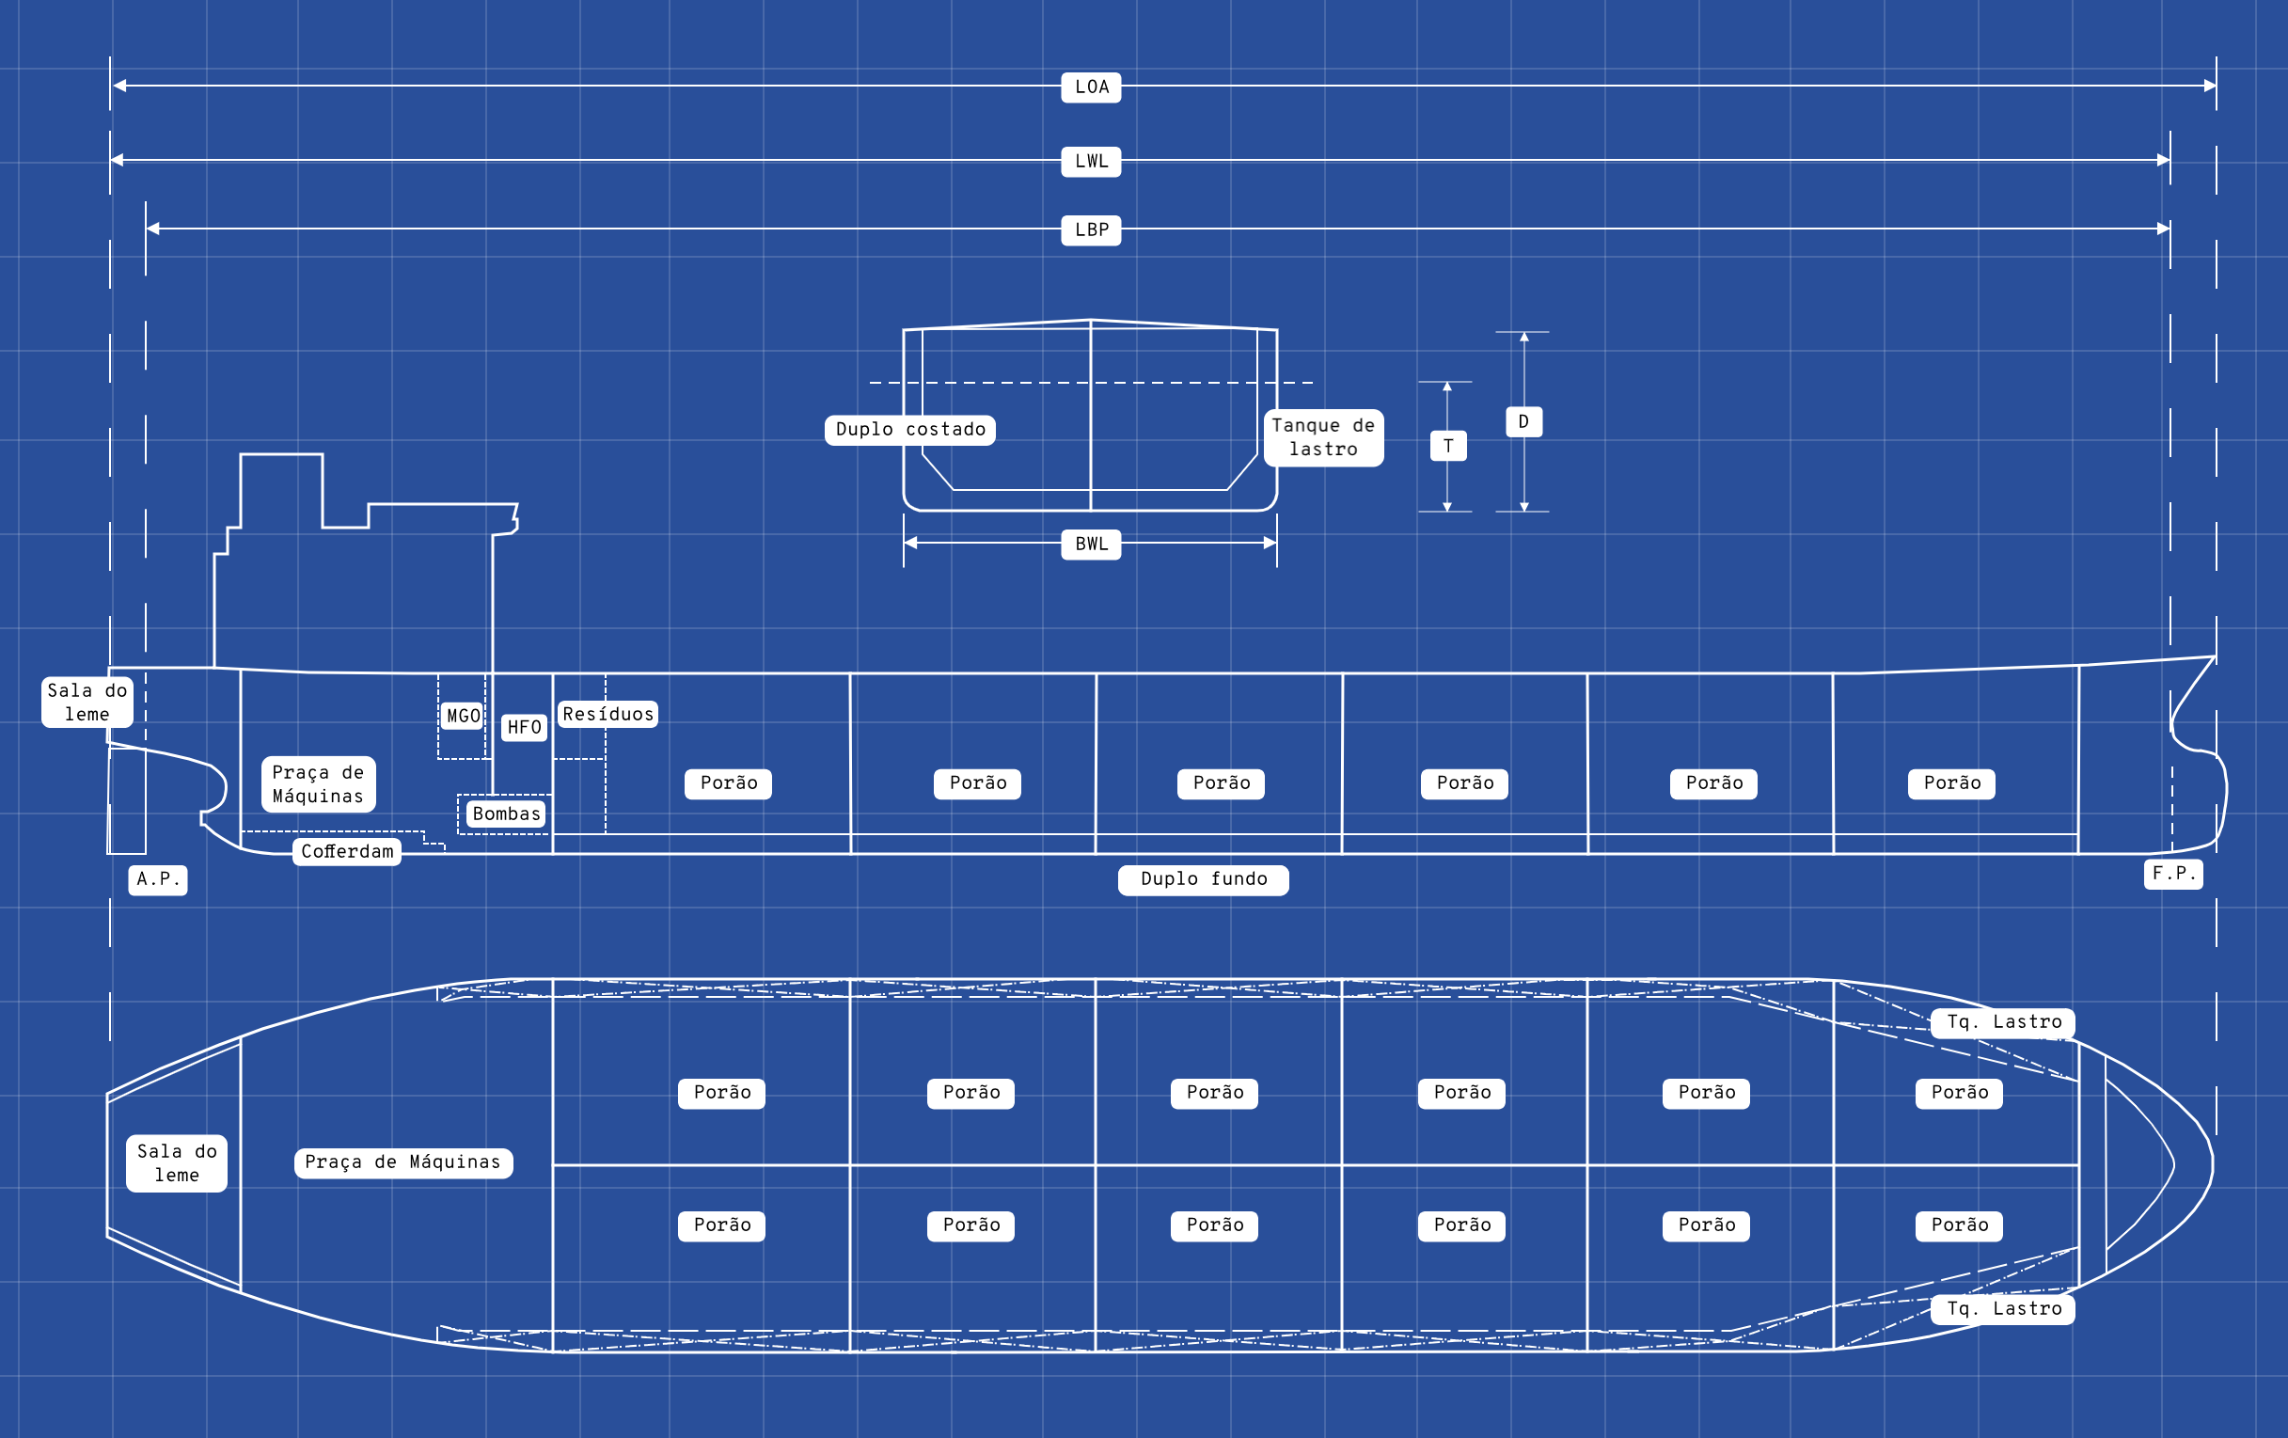
DIMENSIONS AND
d
COMPARTMENTS
B
B
Load
Load
Load
Load
Load
Load
Load
Load
Load
Load
Load
Load
Load
Load
Load
Load
Load
Load
12

Slide 12
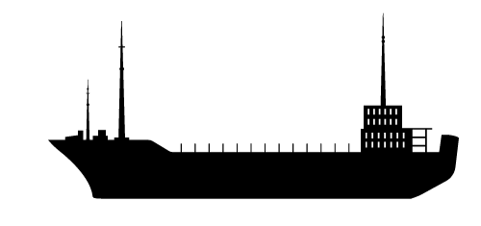


METHODOLOGY
FIRST ESTIMATES
Analysis of DWT scatter and correlation plots by main dimensions (LBP, B, D and d);
Verification of patterns and possible regressions;
Data processing (local analysis and outlier removal);
Verification of the infeasibility of regression in the local analysis;
Calculation of descriptive statistics (main and dimensionless dimensions).
ANALYSIS OF
DATABASES
Main dimensions from the report of theUniv. of Denmark (Kristensen, 2012)and its database;
Dimensionless byShip Design and Construction (Parsons, 2003).
COMPARISON
OF OTHERREFERENCES
13

Slide 13
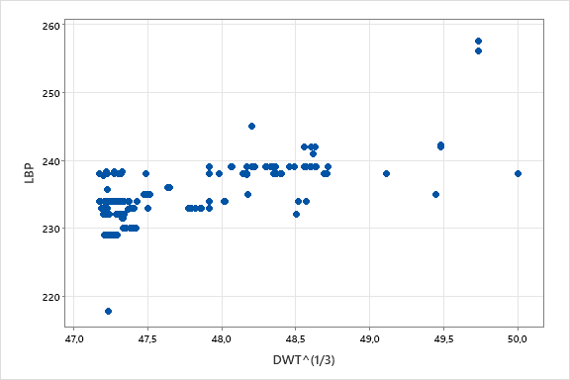
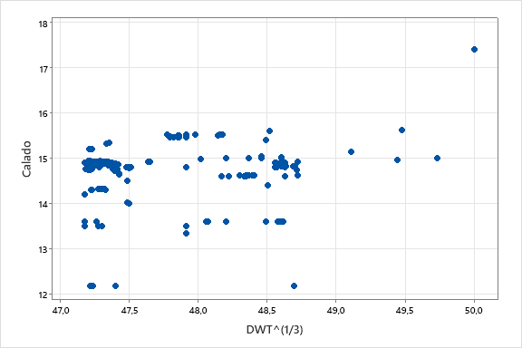
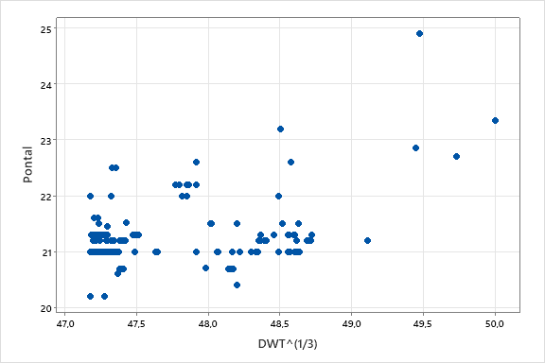
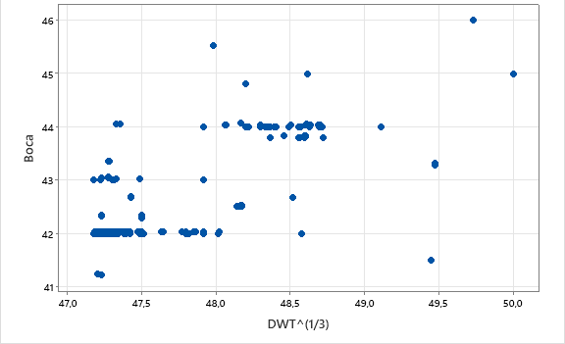
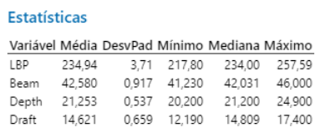

DIMENSIONS MAIN
390 ships
(DWT from 62,500 to 321,000)
1537 ships
(DWT from 525 to 441893)
Local analysis: Added the two databases, analyzing ships between 105,000 tons and 126,000 tons DWT
(+/- 10,500ton of the requirement).
Total of 331 similar ships.
14

Slide 14
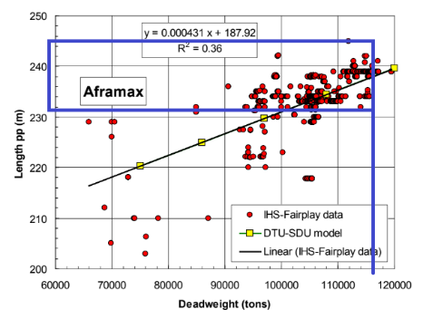
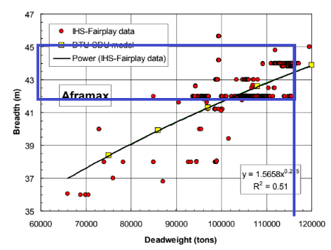

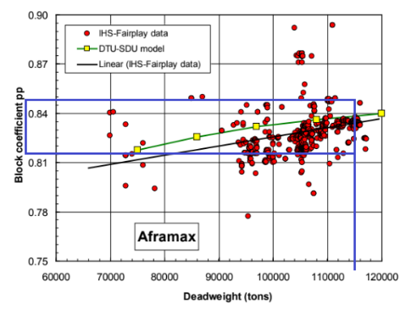
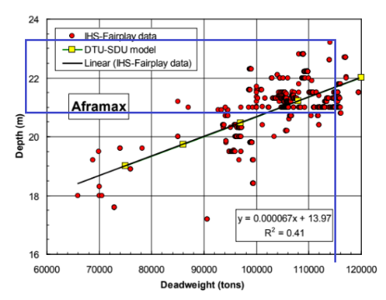
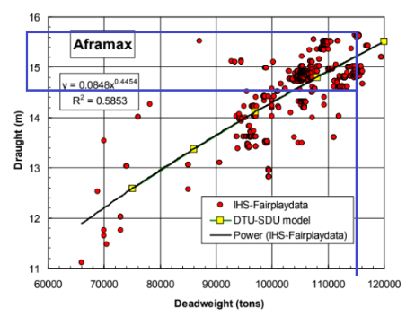
DIMENSIONS MAIN
Hans Otto
Kristensen
Linear regression: tanker ships of various sizes. Although there is a linear regression (note the low r²), only the deadweight range required by the shipowner will be analyzed.
LBP from 232 to 245, with a typical value of 239.
B from 42 to 45, with typical values of 42, 43 and 44.3
CB from 0.81 to 0.85, with a typical value of 0.84.
D from 20.8 to 23.5, with typical values from 21 to 22.
d from 14.5 to 15.7.
15

Slide 15
CENTER OF GRAVITYIN TWO CONDITIONS
LOADED:
This condition implies maximum draft;
Preferabletrim close to zero.
BALLAST:
This condition implies minimum draft;
If there istrim, preferable >0;
LCG loaded
Component | Position (m) | Weight (ton)
Lightweight | 112.43 | 22,866.21
Total deadweight | 131.70 | 116,779.21
Total | 128.55 | 139,645.41
LCG ballast
Component | Position (m) | Weight (ton)
Lightweight | 112.43 | 22,866.21
Total deadweight | 134.80 | 58,090.26
Total | 128.48 | 80,956.47
VCG Loaded
Component | Position (m) | Weight (ton)
Lightweight | 12.05 | 22,866.21
Total deadweight | 12.74 | 116,779.21
Total | 12.63 | 139,645.41
VCG Ballast
Component | Position (m) | Weight (ton)
Lightweight | 12.05 | 22,866.21
Total deadweight | 11.46 | 58,090.26
Total | 11.62 | 80,956.47
46

